Slide 1

Health Equity in Maternal and Infant Health
New York State Perinatal Association Conference
June 7, 2018
Kelly Davis, MPA
Director, NYC Birth Equity Initiative
Bureau of Maternal, Infant and Reproductive Health
Division of Family and Child Health
New York City Department of Health and Mental Hygiene
CONFIDENTIAL AND PROPRIETARY
Any use of this material without specific permission of DOHMH is strictly prohibited

Slide 2
Objectives
Infant and maternal health in NYC
  The social and medical impact of oppression on women of color
Approaches to reducing racial disparities
How we can work together to do better

Slide 3
Decline in Infant Mortality Rate in NYC has Slowed Over the Last 10+ Years
Source: Bureau of Vital Statistics; compiled by BMIRH

Slide 4
Despite Overall Decline in IMR, Disparities by Race/Ethnicity Remain, NYC 2016
Source: Bureau of Vital Statistics; compiled by BMIRH

Slide 5
Differential Decline in Infant Mortality Rate by Race/Ethnicity

Slide 6

“The baby is the candy, the mom is the wrapper. And once the candy is out of the wrapper, the wrapper is cast aside.”
-- Alison Stuebe, MD, MSc, University of North Carolina

Slide 7
NYC Surveillance Reports, 2001-2015
2001-2005
2006-2010
2011-2015
Pregnancy-Associated Mortality
New York City,
2011-2015
Publish by end-2018

Slide 8

Maternal Deaths
Near Miss
Severe Maternal Morbidity
Morbidity
Severity

Slide 9
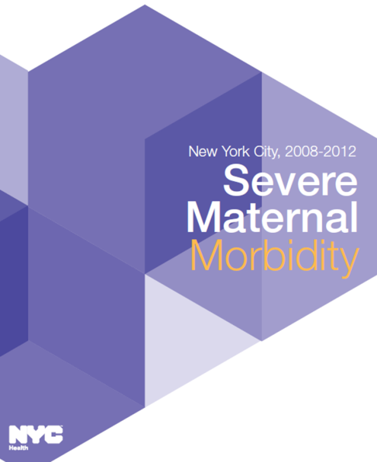
Severe Maternal Morbidity

Slide 10
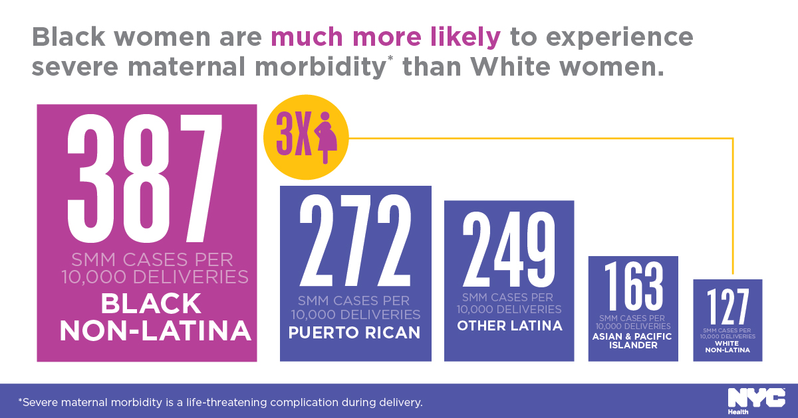
NYC SMM Surveillance Findings, 2008-2012

Slide 11

Class ≠ Race

Slide 12
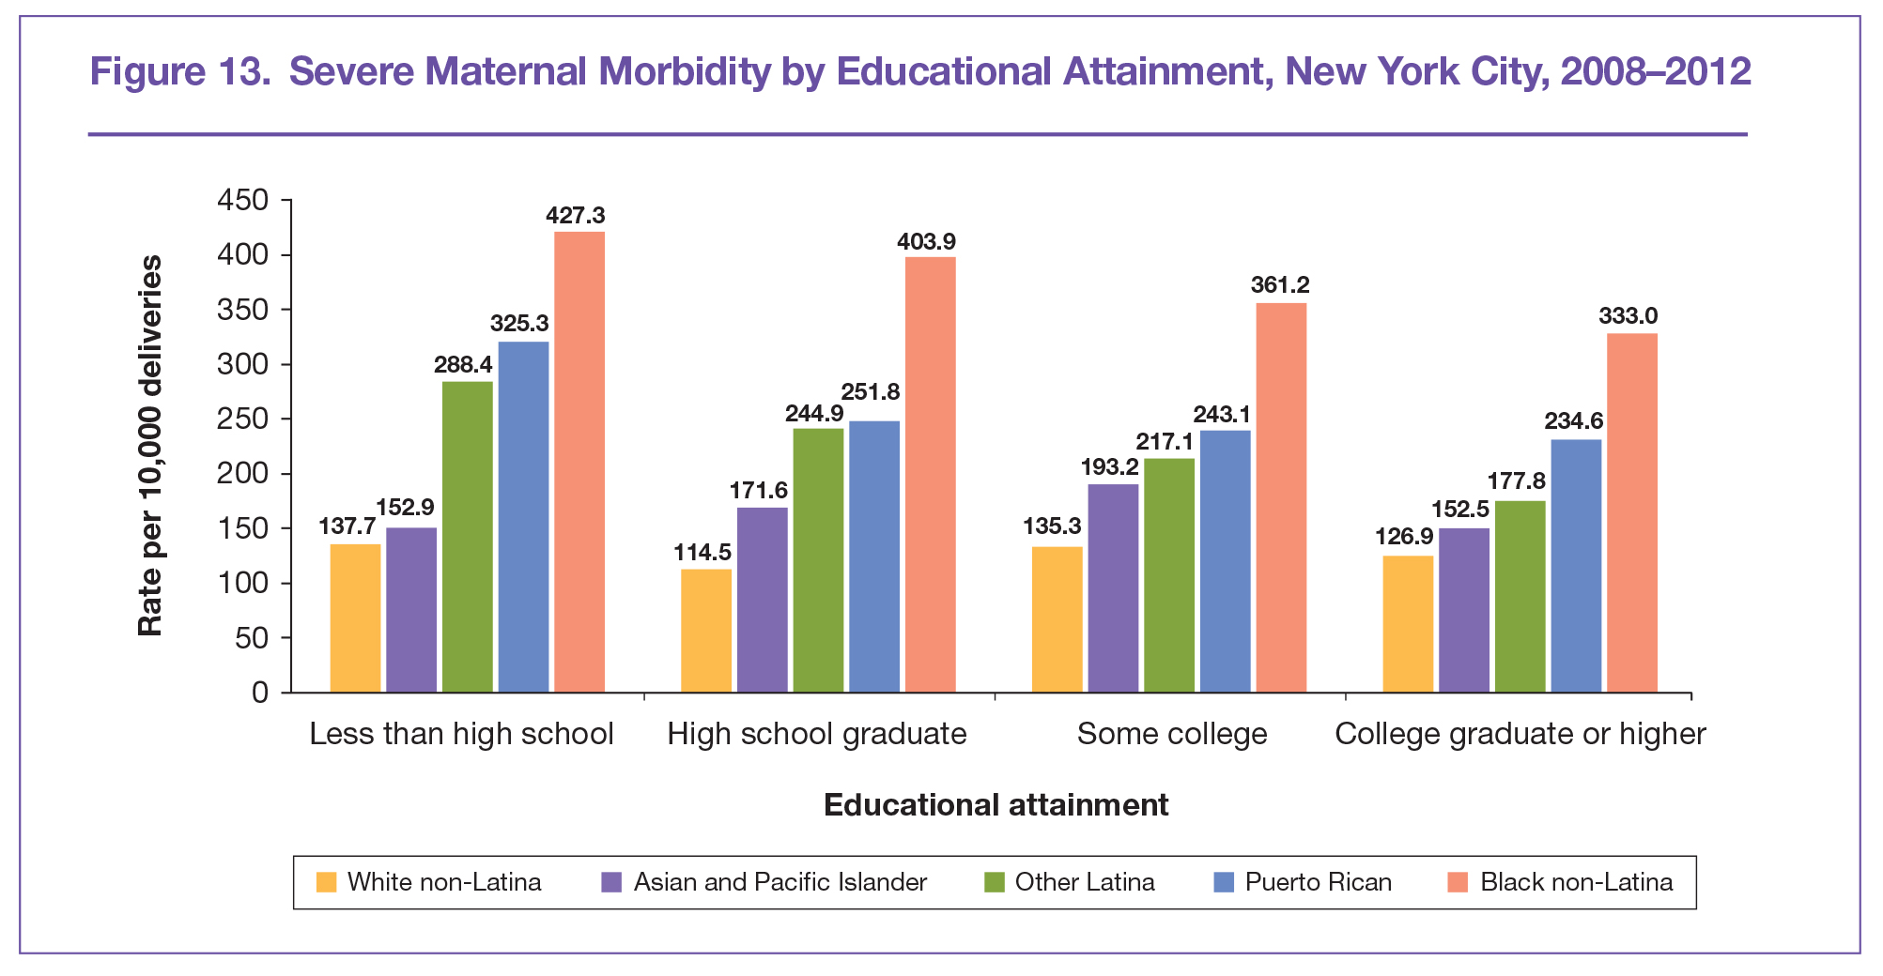
College-educated Black women had higher SMM rates than ALL other women with less than a high school education
Source: New York City Department of Health and Mental Hygiene (2016).
Severe Maternal Morbidity in New York City, 2008-2012. New York, NY.

Slide 13
RACISM
What’s Driving the Disparity?

Slide 14

J. Marion Sims Statue
Photo: The Atlantic, 2018

Slide 15
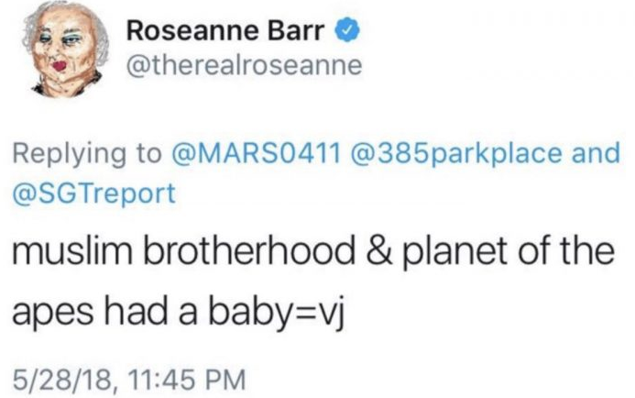

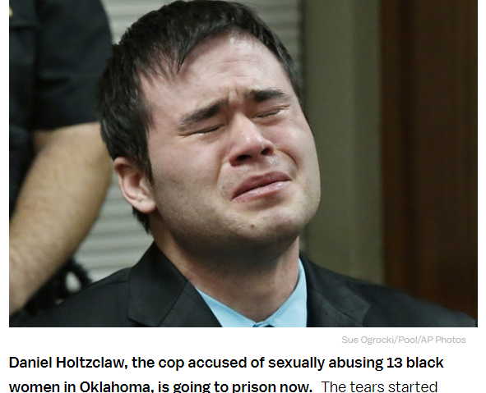
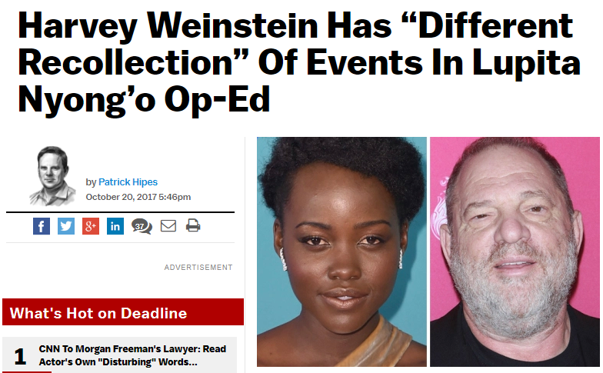

Slide 16

How Racism Shows Up
Drivers
Social Determinants
Unsafe sleep conditions → sleep-related injury deaths
Safe sleep and housing quality
Maternal stress and depression
→ LBW, preterm birth
Toxic stress and trauma
Chronic health conditions → LBW, preterm birth, SMM
Women’s health

Slide 17

Birth Equity in NYC
New York City has adopted a comprehensive approach to address the root causes of persistent, unacceptable and preventable racial/ethnic disparities in infant mortality and severe maternal morbidity.

Slide 18

NYC Initiatives Explicitly Aimed at
MM/SMM Racial/Ethnic Disparities
    Maternal Mortality and Morbidity Steering and Review Committees (M3RC)
    Severe Maternal Morbidity Project
    Maternal Care Connection

Slide 19
Maternal Mortality and Morbidity Review Committee (M3RC)
Multidisciplinary expert group reviews maternal deaths to determine cause, preventability and contributory factors at all levels: individual, community, provider, facility and systems
Conducts a holistic review of maternal deaths from clinical and social determinants of health perspectives

Slide 20
SMM Project (2017-2019)
LONG-TERM GOAL: Promote health equity and ELIMINATE racial/ethnic disparities
in preventable maternal mortality and severe maternal morbidity in nyC
Strategy 1
Initiate sustainable SMM reviews in select facilities for quality improvement and integration into the citywide M3RC
Strategy 2
Use SMM data to inform facility quality improvement, and policy and programmatic change
Strategy 3
Engage, educate and support neighborhoods to address quality of care, chronic disease, and social conditions that increase SMM risk
Strategy 4
Strengthen the policy environment in NYC to support improved maternal health

Slide 21

Maternal Care Connection
Strategy #1
  Work with hospitals to implement best practices in obstetric care
Strategy #2
  Work with PPCs and hospitals to improve chronic disease diagnosis and treatment
Strategy #3
  Mobilize community residents and providers for respectful, quality maternity care

Slide 22
“Do the best you can until you know better.
Then when you know better, do better.”
― Maya Angelou
We know better. Now we have to DO better.
But how?

Slide 23
#1.Trust (and Hire) Black Women
(and Latinx, Indigenous, immigrant & queer folk, too!)

Slide 24
#2. Adopt a Sexual and Reproductive Justice Framework

Slide 25
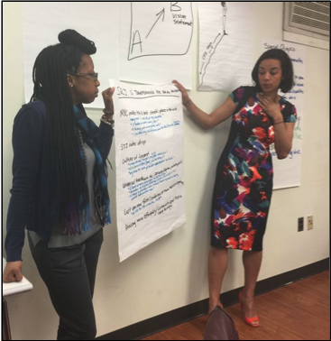
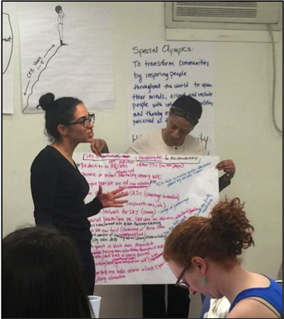
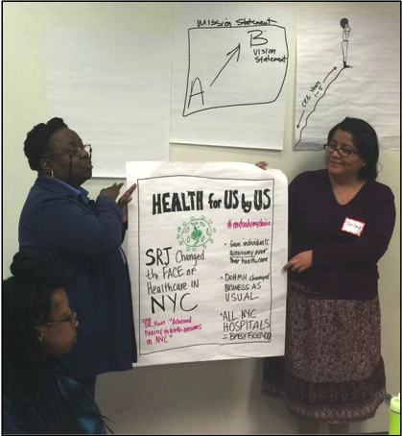
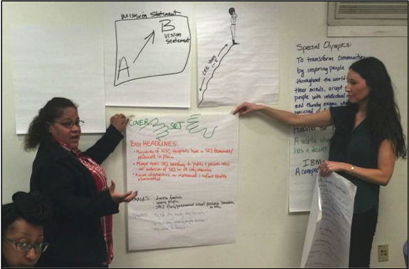
Sexual and Reproductive Justice Community Engagement Group
Building trusting partnerships
Shared Leadership
Common goals
To Date:
57+ Community Organizations
25 Monthly Meetings

Slide 26
Doing Better
#3. Holistic Healthcare

Slide 27

Thank you!
Kelly Davis, MPA
kdavis2@health.nyc.gov

